Slide 1
Big Data Introduction
Dec 2017

Slide 2
Contents
Definitions
Origins of Big Data
Case Studies and Motivations

Slide 3
Big Data definition
Data of a very large size, typically to the extent that its manipulation and management present significant logistical challenges
Oxford English Dictionary

Slide 4
Gartner
Big data is high-volume, high-velocity and high-variety information assets that demand cost-effective, innovative forms of information processing for enhanced insight and decision making.

Slide 5
The three Vs
Velocity
Need to be able to process data faster
Handle very large numbers of data elements/sec incoming
Variety
Not just the same old columns
New formats, new sources, new details
Volume
Massive volumes are becoming normal
Collecting the next level of data
E.g. Bank Trades, Website interactions, shopping experiences, etc

Slide 6
My Big Data definition
Any data storage and analysis that:
Cannot be processed on a single machine in a timely manner
Over time needs more computation and resources than a fixed size system can provide

Slide 7
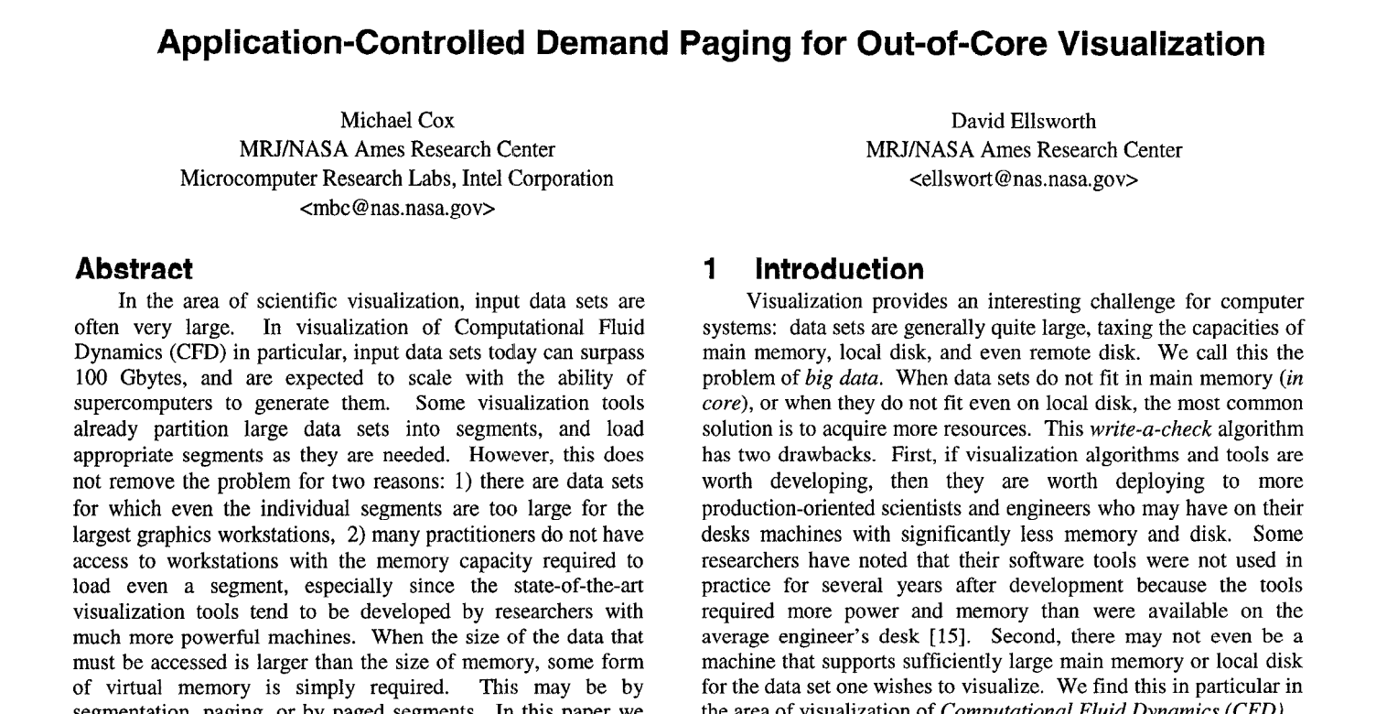
Origins of Big Data - 1997

Slide 8
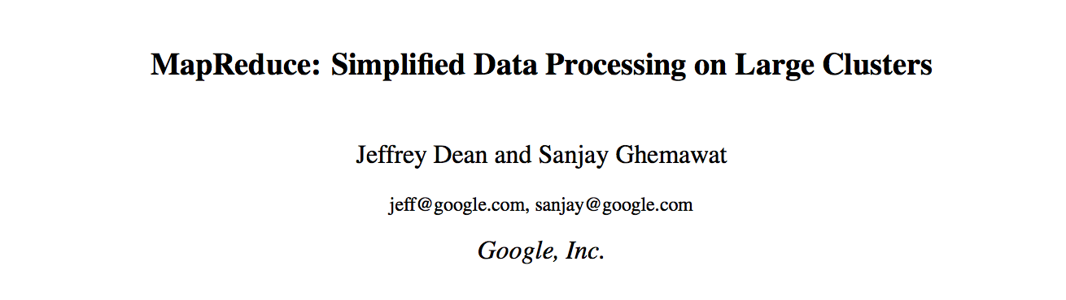
Map Reduce 2008

Slide 9
Master Data
One widely used approach
You ingest core data and never change it
You can create summaries, cleaned data, etc
But the original data is immutable
Cheap disk space…
Related to Event Sourcing

Slide 10
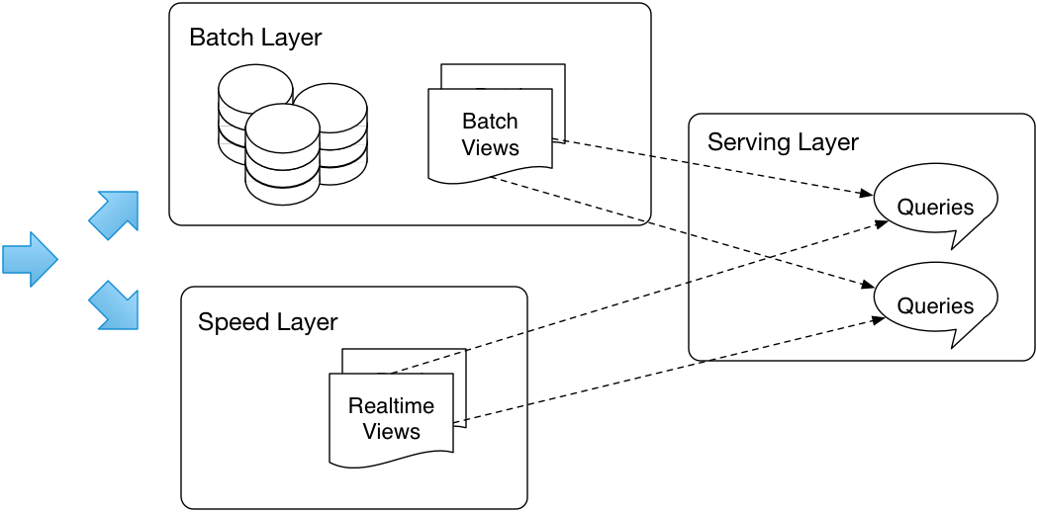
Lambda Architecture

Slide 11
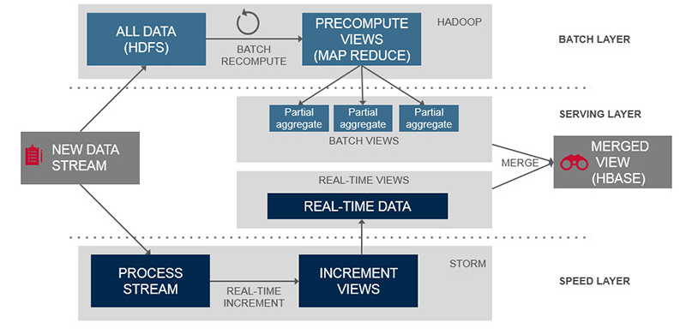
Lambda Architecture (MapR)

Slide 12
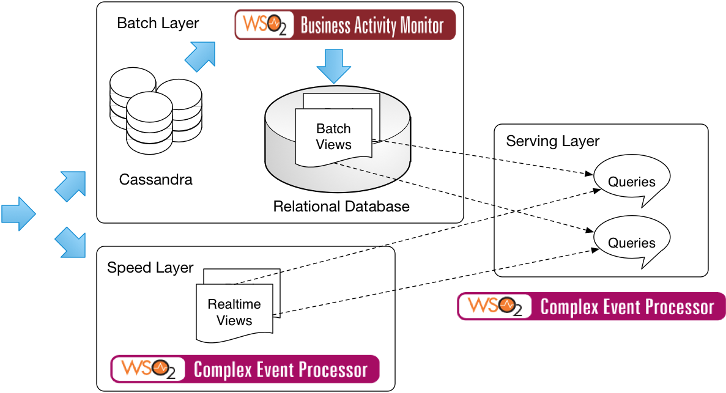
Lambda Architecture instantiation (WSO2)

Slide 13
Big Data technologies
Map Reduce
Hadoop, Spark, etc
In-Memory Directed Acyclic Graphs
Spark, Tez
Realtime Stream processing
Spark, Storm, Siddhi
NoSQL
Cassandra, Mongo, CouchDB, etc
Statistical Analysis
R, SparkR, MapR
Machine Learning
Mahout, MLlib, TensorFlow

Slide 14

Why Python?

Slide 15
Python for Big Data
Python is a great language for Data Science
NumPy, Pandas, many graphic packages
Python is a great language for Spark
Lambdas, concise statements, DataFrames
Ipython/Jupyter is a great notebook

Slide 16
Other options
C/C++ are fast to run, but generally slow to develop
Scala is an even better language for Spark
But not so strong in wider data science
Java is too wordy for Data Science!
R is a great model for both Data Science and Spark, if you are a statistician
Do not even consider Perl ;-)

Slide 17
Notebooks
Web-based systems that combine documentation, code and graphics into one place
Two front runners for Big Data
Jupyter (formerly IPython)
Based on Python but supporting other languages
Apache Zeppelin
More language neutral but newer and more buggy (this may be changing of course)

Slide 18
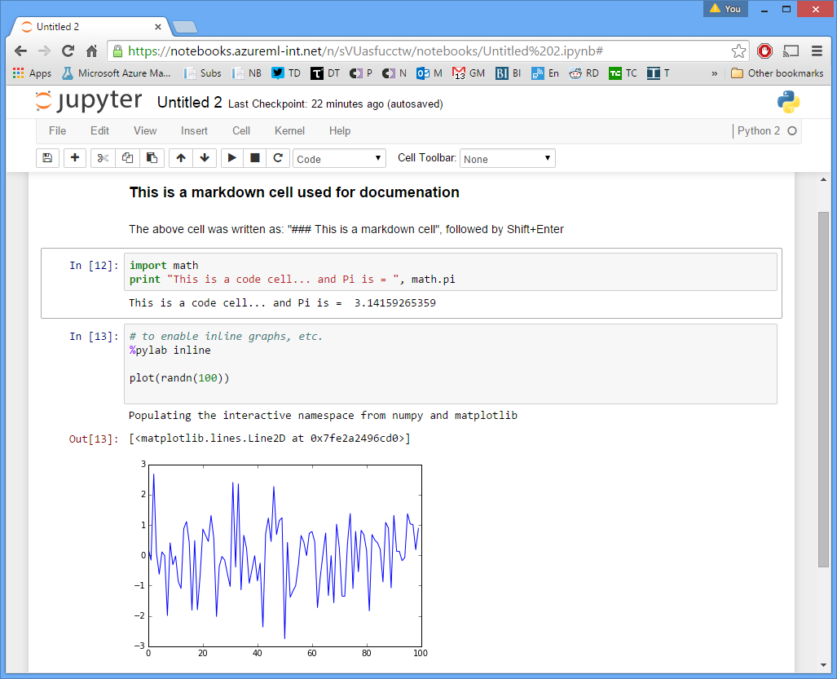

Slide 19
Numpy
Numerical and scientific analysis library in Python
(sudo) pip install numpy
Foundation of most data analysis in Python
Based on arrays of data

Slide 20
Base ecosystem
scipy
pandas
matplotlib
numpy

Slide 21
Pandas
A rich relational data model built on top of Python’s numpy
Emerged from the finance industry
Like R’s data.frame (but maybe better?)

Slide 22
Matplotlib
A simple graphing library for Python
Works well with Pandas and Numpy
Integrated into Jupyter
There are many alternatives
E.g. Bokeh

Slide 23
This course
Python
pandas
matplotlib
pyspark
Apache Spark with Python
Jupyter
Some other libraries etc as we go

Slide 24

Recommended
Reading!
(take a look at my copy)

Slide 25
Case studies

Slide 26
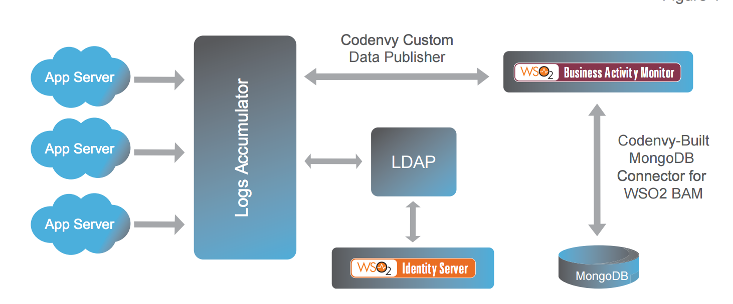
Big Data Cloud management analytics

Slide 27
Realtime Big Data
New York-based Bank
25 servers in a cluster analysing trading and system data from operational systems
Siddhi-based engine processing data in realtime
Handling 10,000s of events/second

Slide 28
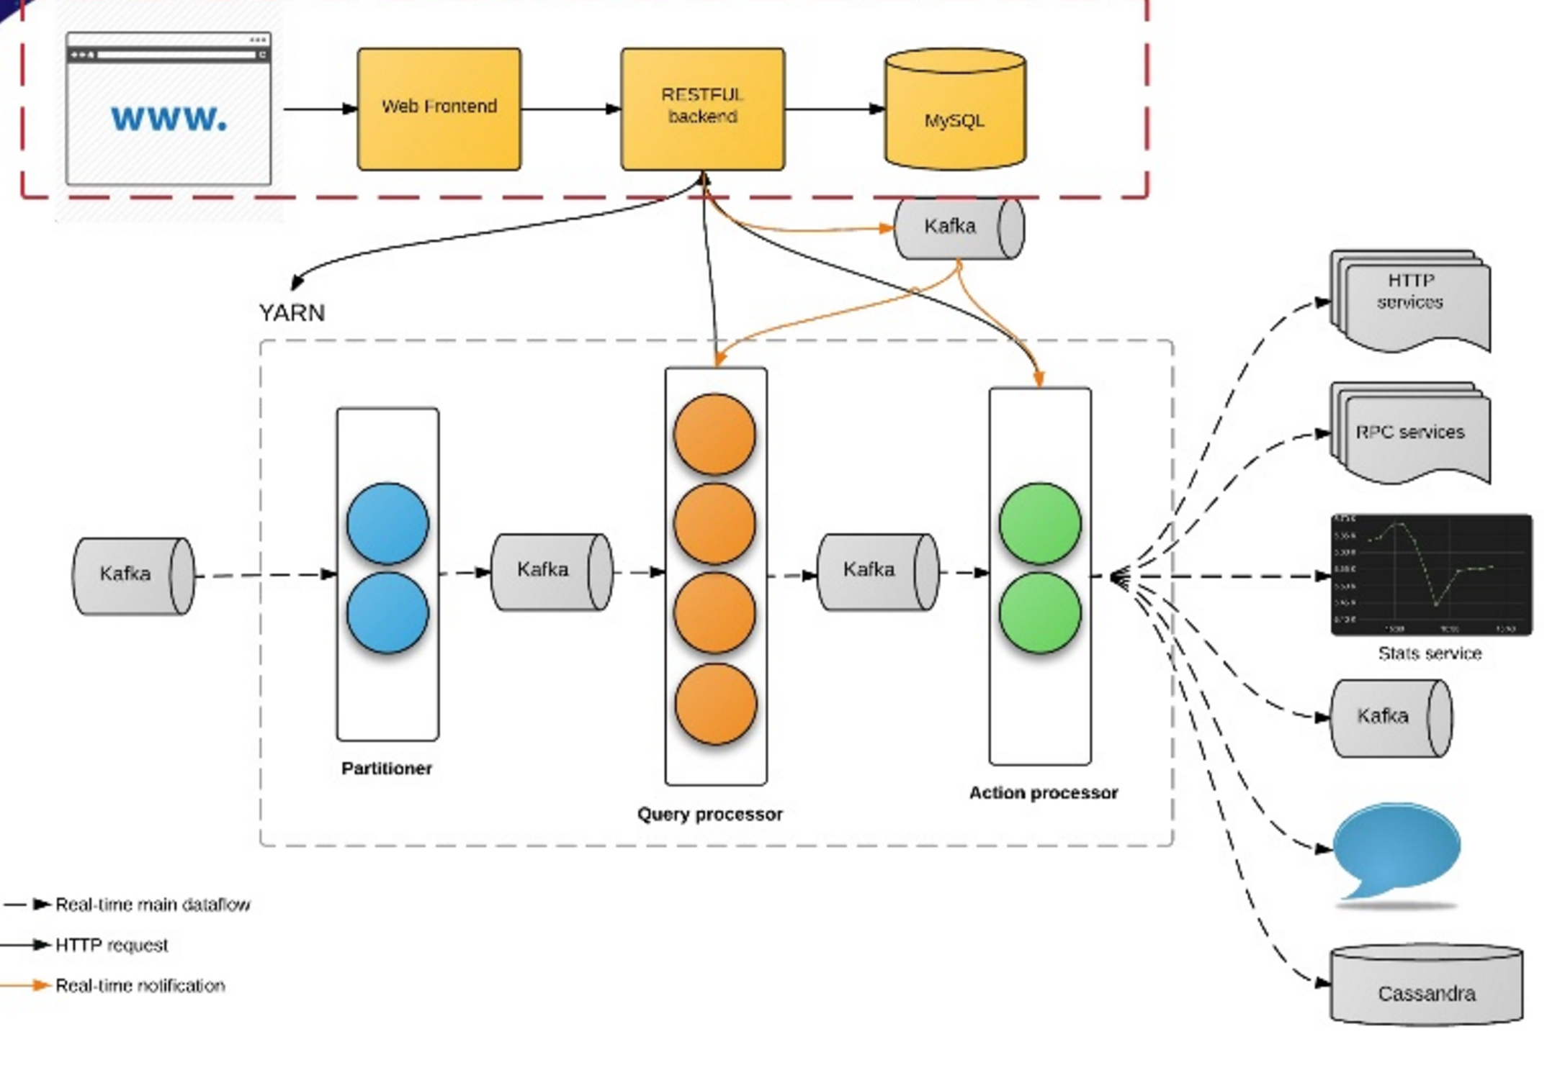
Realtime Big Data at Uber

Slide 29
Realtime Big Data at Uber
100+ production apps
30 billion messages / day
347,000 messages / second
Fraud, anomaly detection
Marketing, promotion
Monitoring, feedback
Real time analytics and visualization
https://freo.me/siddhi-uber

Slide 30
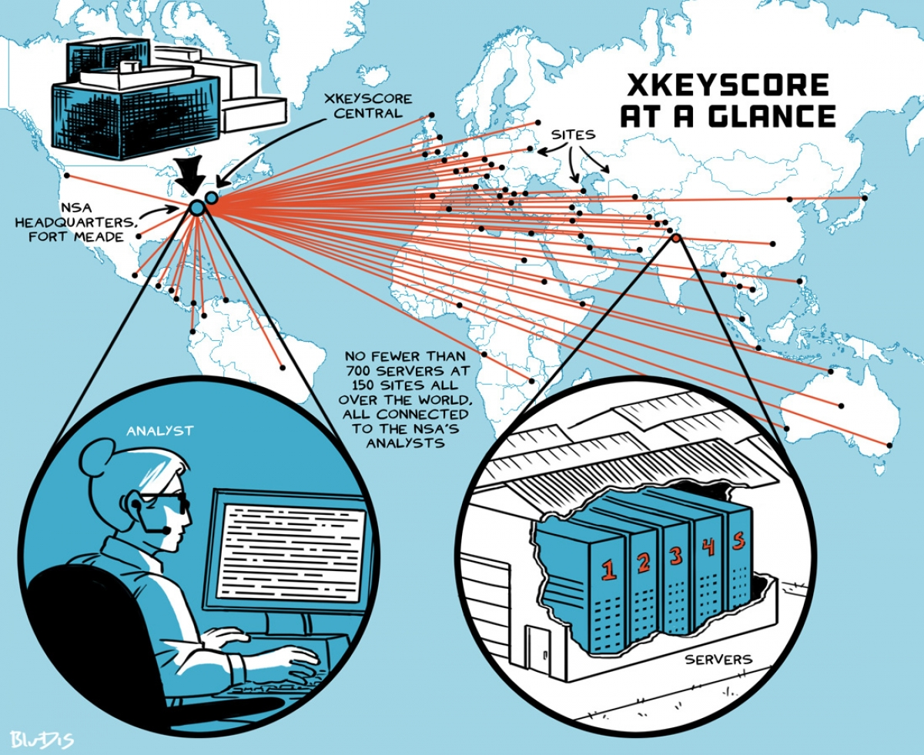
https://firstlook.org/theintercept/2015/07/01/nsas-google-worlds-private-communications/

Slide 31
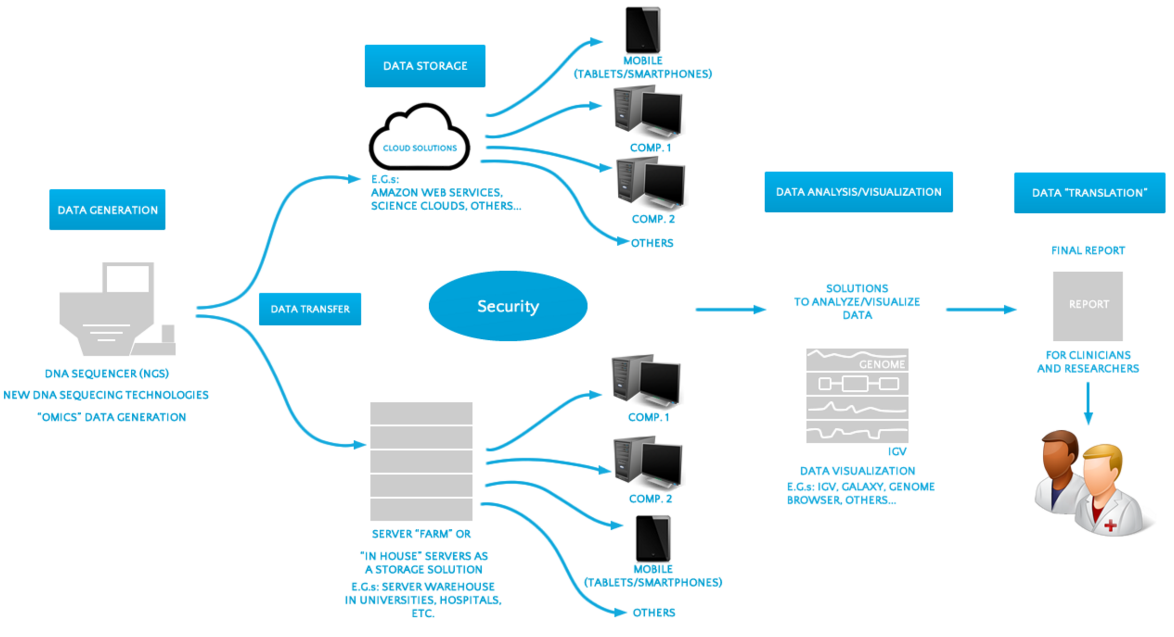
Big Data in Genomics http://www.laboratory-journal.com/science/information-technology-it/big-data-genomics-challenges-and-solutions

Slide 32
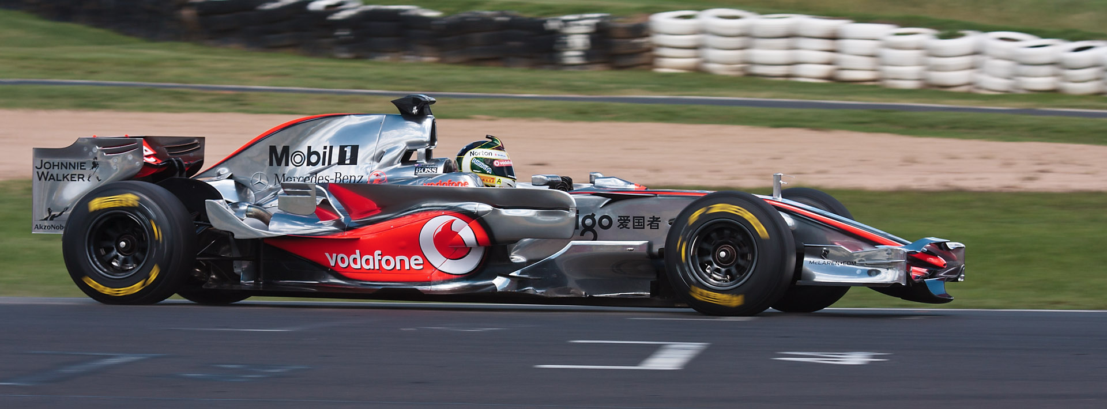
Maclaren Formula 1
Collects 1Gb/race
Analysing in real-time to tune and manage the car

Slide 33
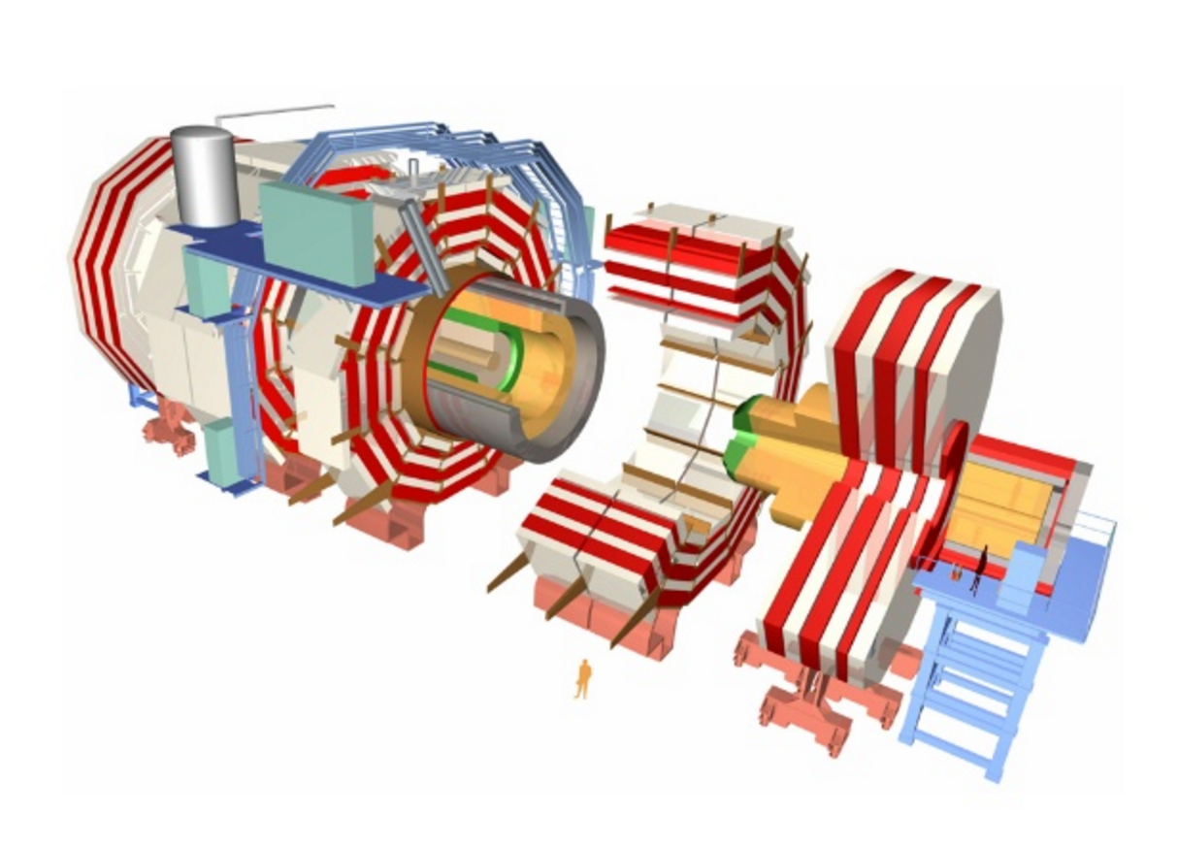

Slide 34
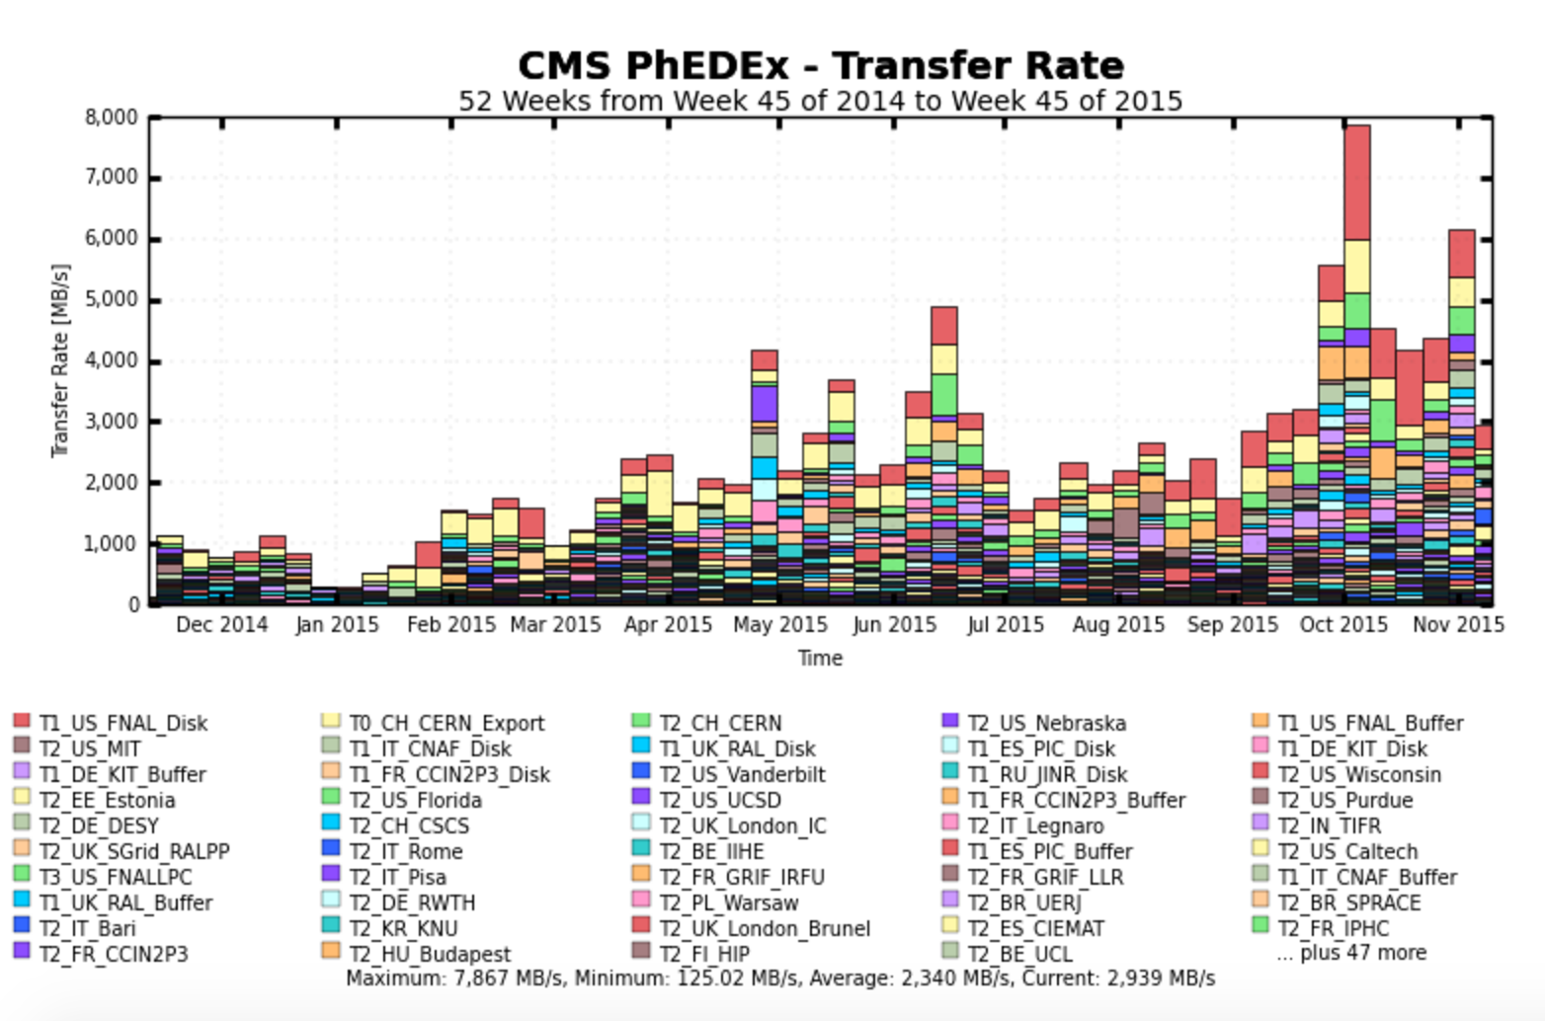
Large Hadron Collider Compact Muon Solenoid Experiment Source: http://cmsweb.cern.ch/phedex

Slide 35
Questions?

